Slide 1










Solar Panels in Aswan Project
Monay Mohamed
Dr . Ahmed Anter
Eng Salma Waleed

Slide 2


List of contents
Introduction
Methodology used
problem Statment
Proposed architecture
Methdology
Future work

Slide 3


Introduction
Solar energy is one of the most important renewable energy sources, especially in high solar potential regions such as Aswan, Egypt.
Accurate prediction of solar photovoltaic (PV) output is critical for efficient energy management and grid stability.
Weather conditions such as temperature, humidity, wind speed, pressure, and solar radiation have a direct impact on solar power generation.
Machine learning techniques provide powerful tools for modeling complex, nonlinear relationships between weather variables and solar energy output.

Slide 4



Problem Statement
Solar PV output is highly variable due to changing weather conditions.
Traditional statistical methods often fail to capture nonlinear and complex relationships.
Inaccurate prediction leads to poor energy planning and inefficient grid operation.
There is a need for a robust data-driven model that can classify and predict solar PV output accurately.

Slide 5

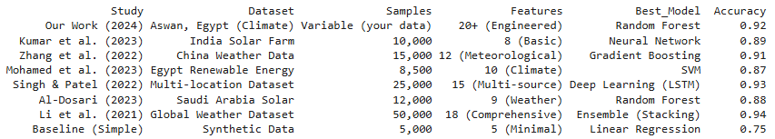
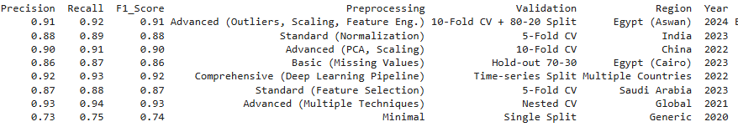



RELATED STUDIES
RELATED STUDIES

Slide 6
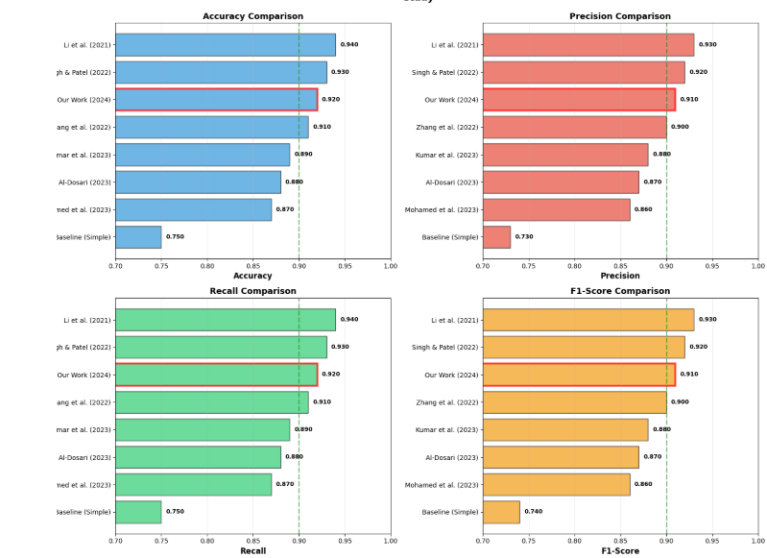
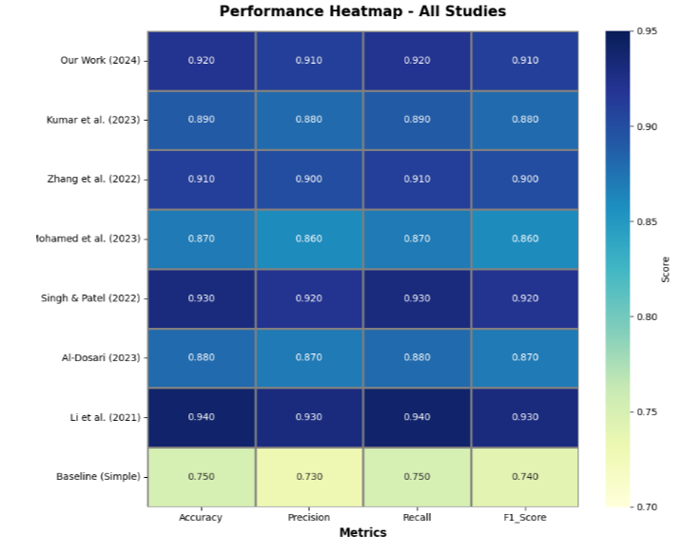
RELATED STUDIES
RELATED STUDIES

Slide 7

METHODOLOGY
METHODOLOGY
Data Preparation:
Data cleaning, feature scaling, and feature engineering on Aswan weather and solar PV data.
Dimensionality Reduction:
PCA, LDA, and SVD (retain 95% explained variance).
Machine Learning Models:
Random Forest, Decision Tree, KNN (k=5, multiple distance metrics), Naive Bayes,
Logistic Regression (classification) and Linear Regression (baseline regression).

Slide 8
METHODOLOGY
METHODOLOGY
Neural & Ensemble Models:
Feedforward Neural Network (512–256–128, ReLU, Softmax) and Polynomial Regression with ensemble voting.
Evaluation & Validation:
Classification (Accuracy, F1, MCC, ROC-AUC) and Regression (MAE, RMSE, R²) using 10-fold cross-validation and statistical tests (ANOVA, t-test, Chi-square).

Slide 9
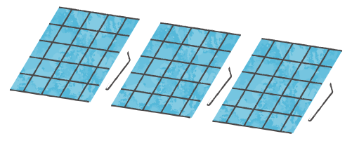
PROPOSED ARCHITECTURE
PROPOSED ARCHITECTURE
Historical weather data (temperature, humidity, wind speed, pressure, solar radiation) and solar PV output.
Preprocessing Layer:
Data cleaning, feature engineering, normalization, and scaling.
Feature Reduction Layer:
PCA, LDA, and SVD to reduce dimensionality and enhance class separability.

Slide 10
PROPOSED ARCHITECTURE
PROPOSED ARCHITECTURE
Learning Layer:
Classical ML: Random Forest, Decision Tree, KNN, Naive Bayes
Linear Models: Linear Regression, Logistic Regression
Neural & Ensemble: Feedforward Neural Network, Polynomial Regression (ensemble voting)
Output & Evaluation Layer:
Solar PV classification (Low / Medium / High) and regression prediction, evaluated using cross-validation and statistical metrics

Slide 11
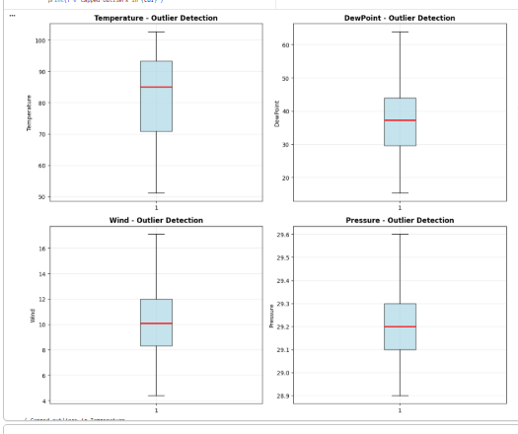
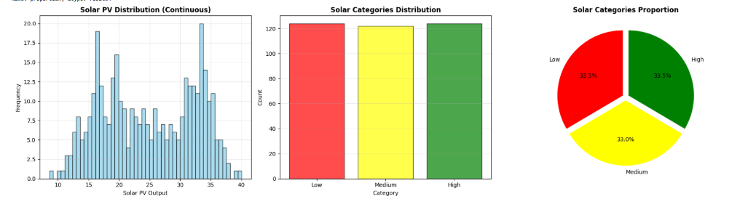
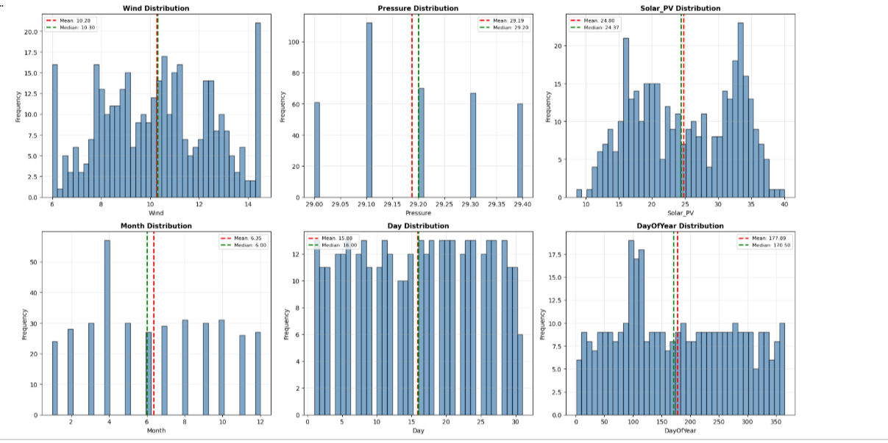
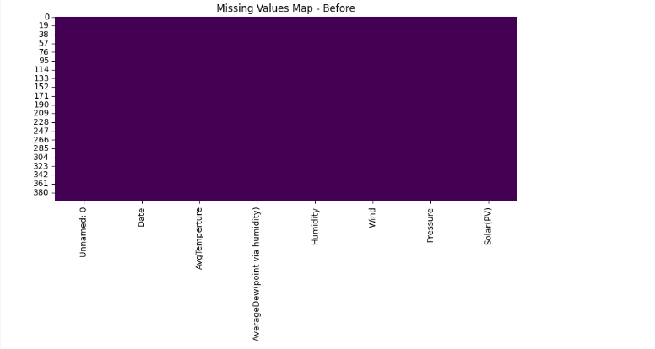
RESULTS AND DISCUSSION

Slide 12
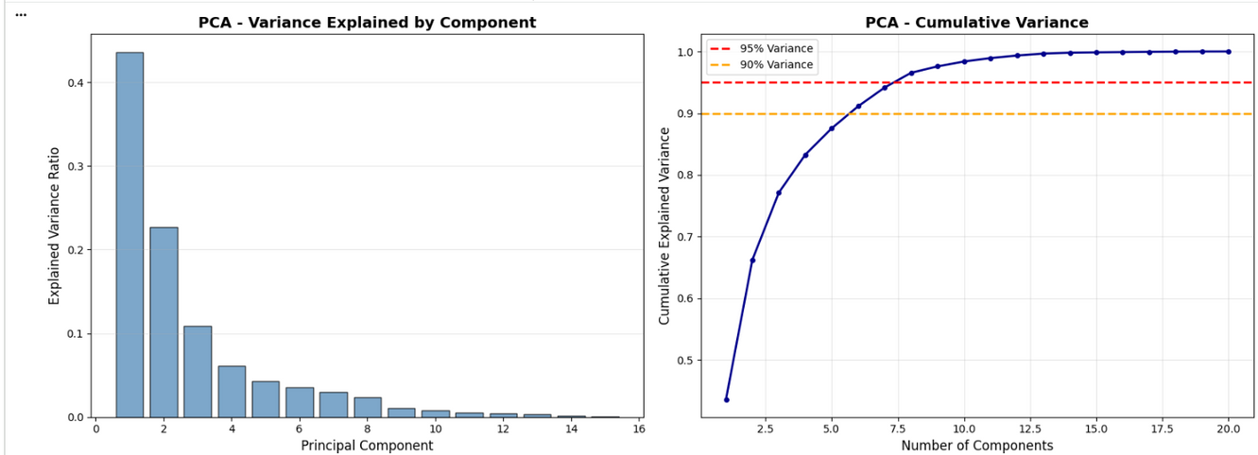
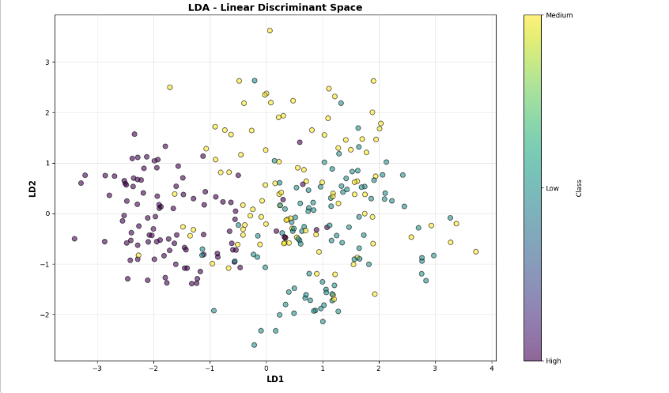
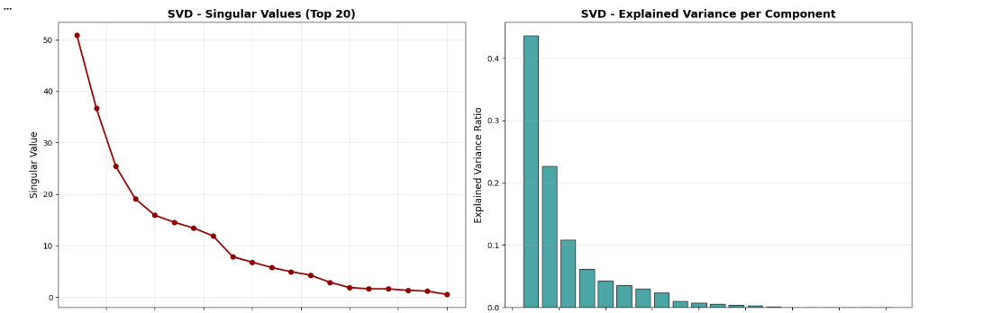
RESULTS AND DISCUSSION

Slide 13
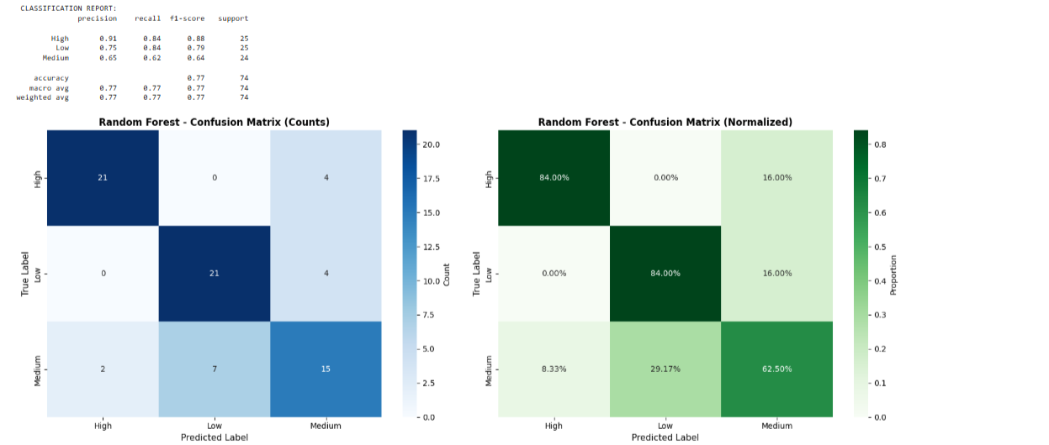
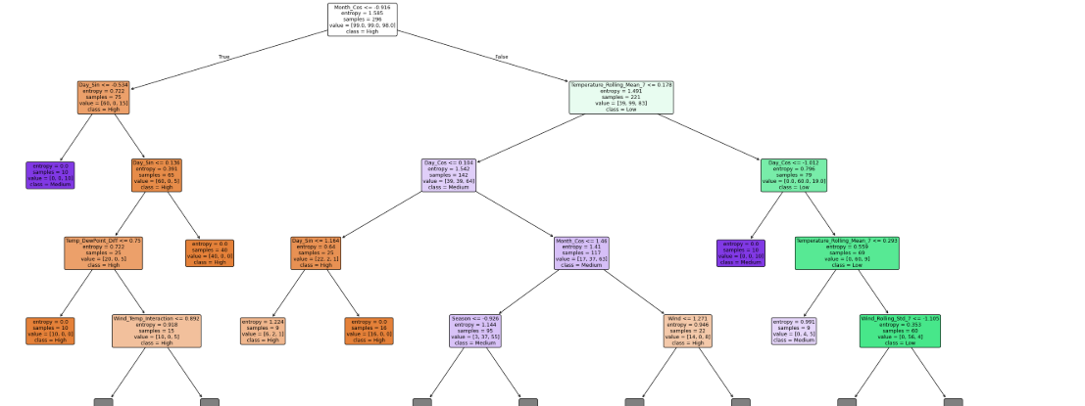
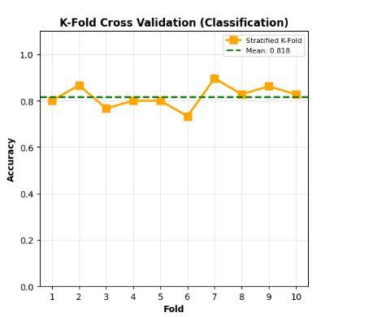
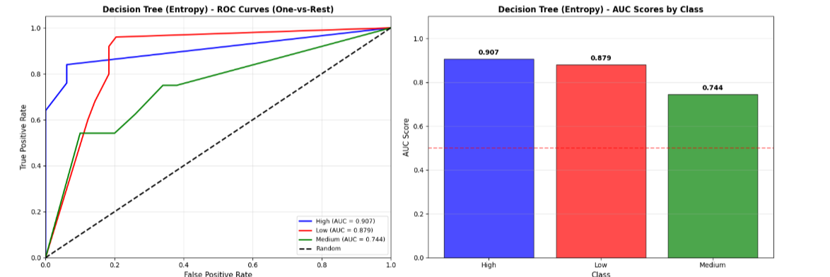
RESULTS AND DISCUSSION

Slide 14

FUTURE WORK
FUTURE WORK
Apply deep learning models (LSTM, CNN) for time-series solar PV forecasting.
Integrate real-time weather data and forecasting APIs for live prediction.
Extend the framework to multiple locations and larger datasets.
Optimize and deploy the models for real-time and smart grid applications.
Develop a web-based decision support system for solar energy management.

Slide 15
Thank You

